Slide 1


Intelligent Academic Planner
Daria Cook, Krystal Elliott, Xiaoyu Zhou
April 21, 2017

Slide 2



First… A Review:
What are we doing?
Using IBM Watson and BlueMix APIs to conduct textual analysis on questions asked and personal information provided by potential students and incoming freshman.
What is the need for this project?
Students are often unsure of which fields would coincide with their interests and talents.
What is our objective with this project?
Enable students to make better career decisions.

Slide 3
Algorithms

Slide 4
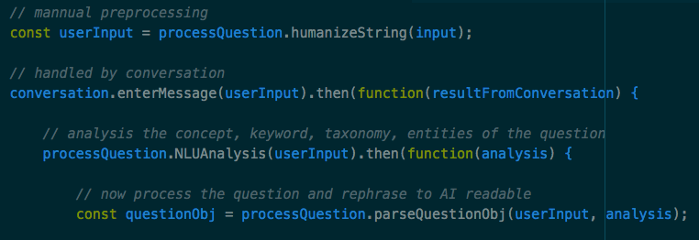
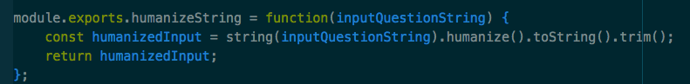
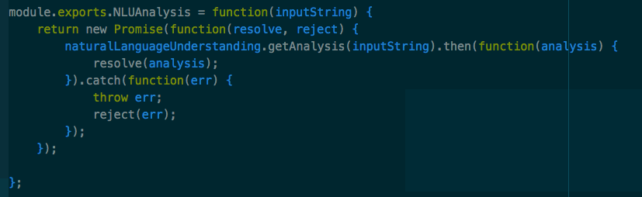
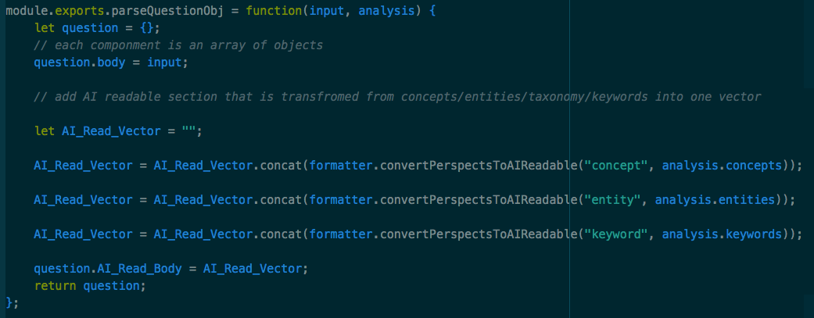
Key Algorithms - Preprocessing Input

Slide 5
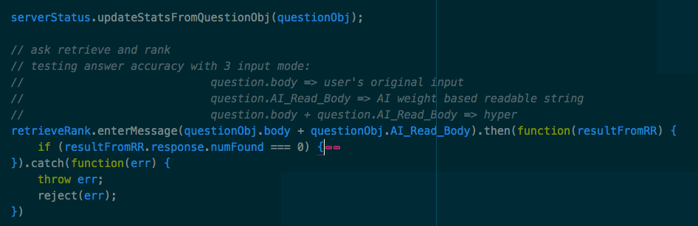
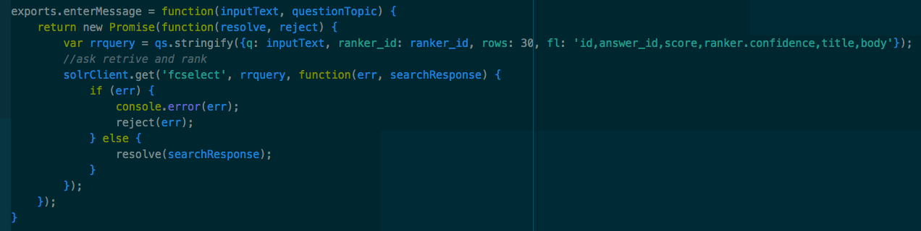
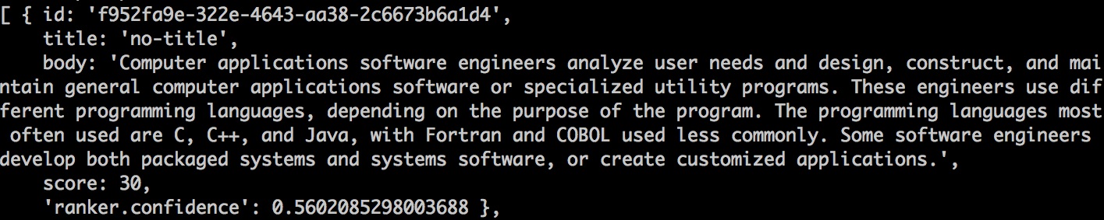
Key Algorithms - Ask AI

Slide 6
Testing

Slide 7
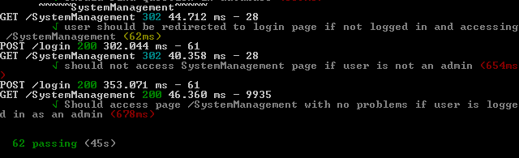
Test Results - Unit & Acceptance Tests
Total of 62 Unit & Acceptance Tests

Slide 8
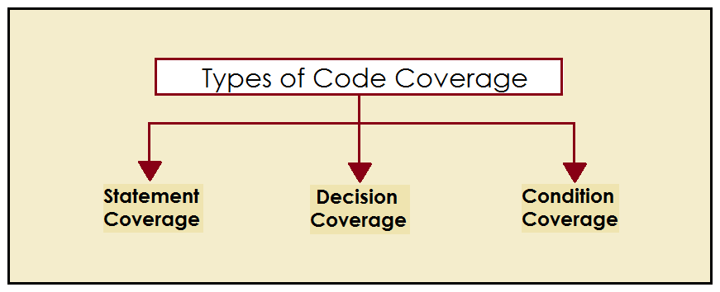
Testing Coverage

Slide 9
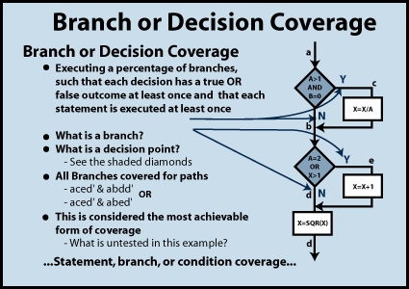
Decision Coverage

Slide 10

Benefits of Decision Coverage
To validate that all the branches in the code are reached
To ensure that no branches lead to any abnormality of the program’s operation
It eliminates problems that occur with statement coverage testing

Slide 11
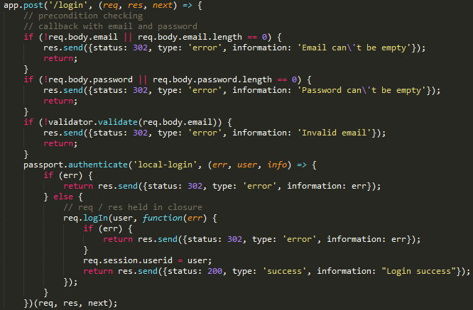
Explanation

Slide 12
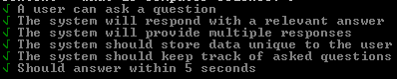
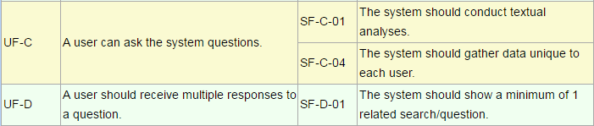
Acceptance Tests

Slide 13
Integration Tests
Performed manually every Thursday
Why?
“Manual testing can be used for integration testing, and in fact should be used to some degree, because automated tests cannot spot all forms of unexpected error conditions. Especially bugs having to do with layout and things not "looking right" (which happen to be rather common in web apps).” - Michael Borgwardt on StackOverflow

Slide 14
System Demonstration
Story Board

Slide 15
Global Impacts
Locally, we hope to impact those interested in Penn State Behrend’s CSSE programs, by offering guidance concerning the decisions pertaining to their future.
On an organizational level, we believe that our tool could be scaled to assist other programs in universities or institutes providing counsel.
Globally, we hope to further the field of knowledge that combines inquiries with a user’s personal information for a custom tailored answer retrieval system.
Notes:
Local - high school > college
Organization - juvenile detention center, where perhaps a user is not yet aware of the opportunities that exist for them
Global - how amazing would it be to ask google a question and for google to provide answers that are suited to you personally? “Teach me to paint” artist? professional?

Slide 16
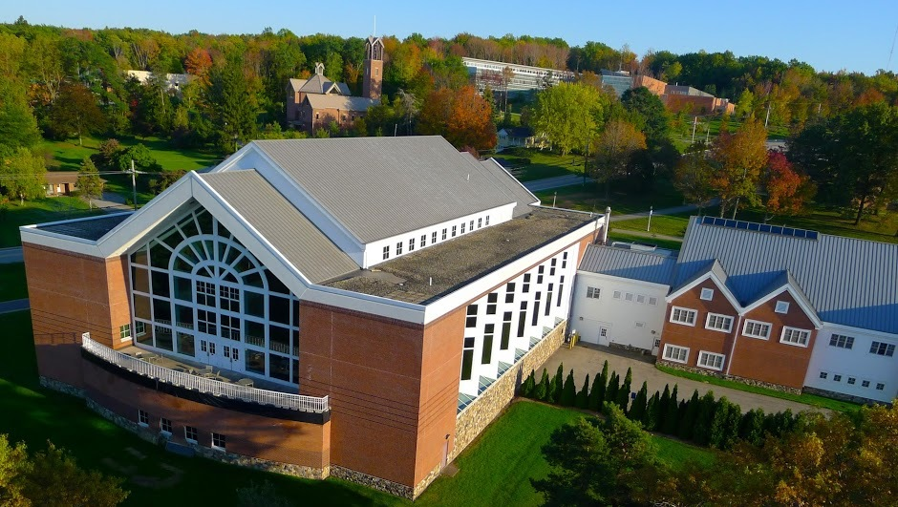

A high school student is considering her future. She is trying to decide which colleges to apply to. She is considering a few factors.
She loves video games.
She wants to be involved in clubs on campus.
She is from Philadelphia, but she wants to live somewhere “green”.

Slide 17
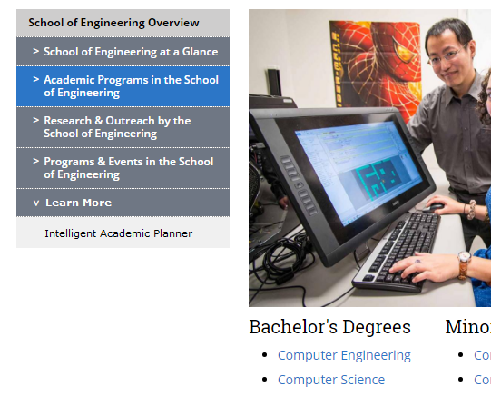

She follows this page’s “Learn More” link to the
“Intelligent Academic Planner”

Slide 18

She is directed to a page with a search bar.
The top of the page reads:
ASK ANYTHING ABOUT BEHREND’S CSSE PROGRAM
There is a “Question Feed” on the side of the page that has questions like: “What is Erie like?” and “What minors can I take?”

Slide 19
The Assessment
Inbox & Report Features

Slide 20
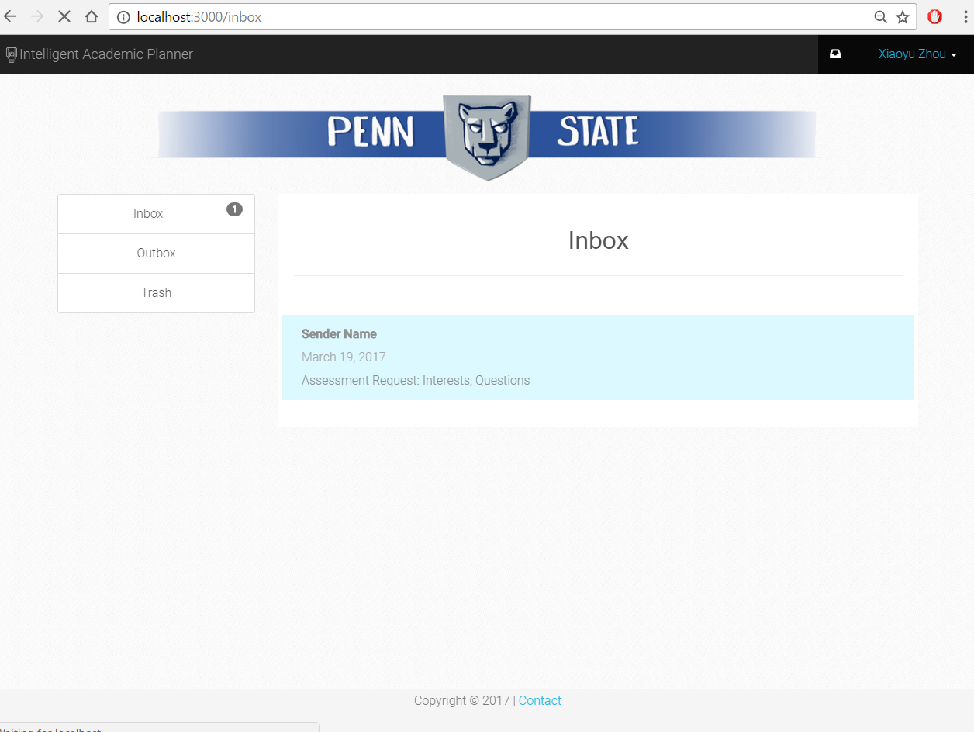

Slide 21
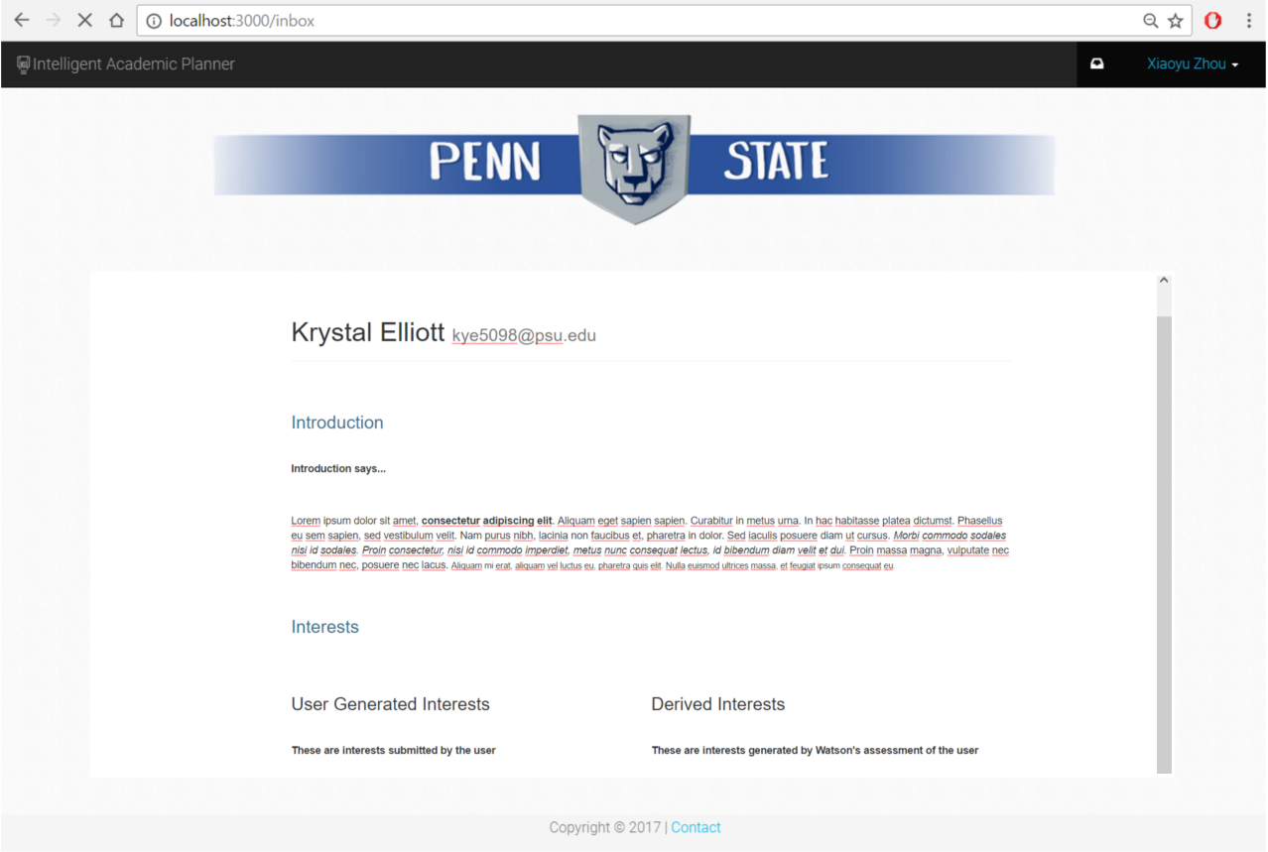

Slide 22
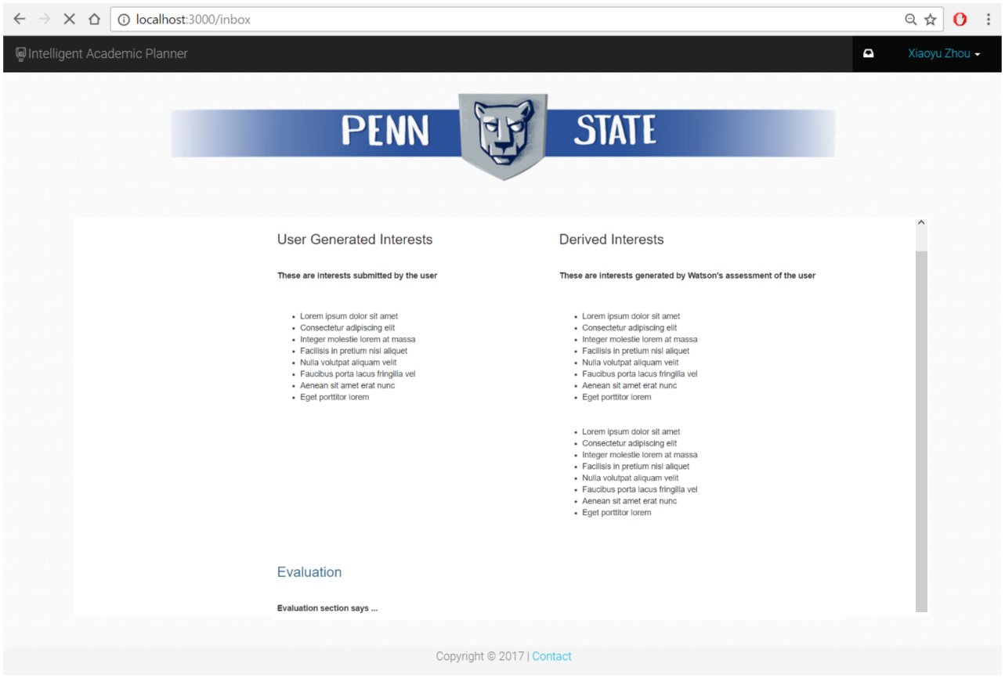

Slide 23
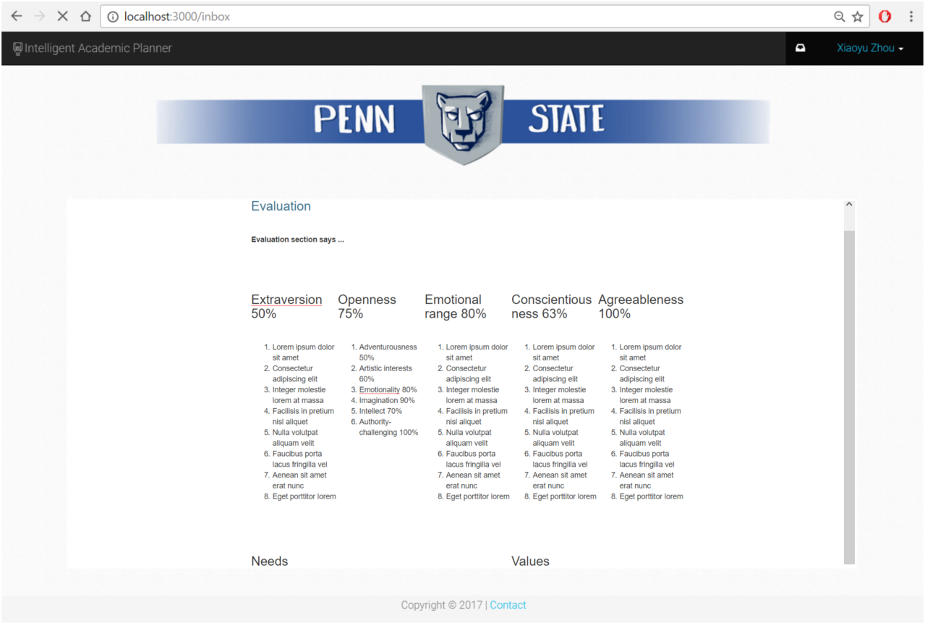

Slide 24
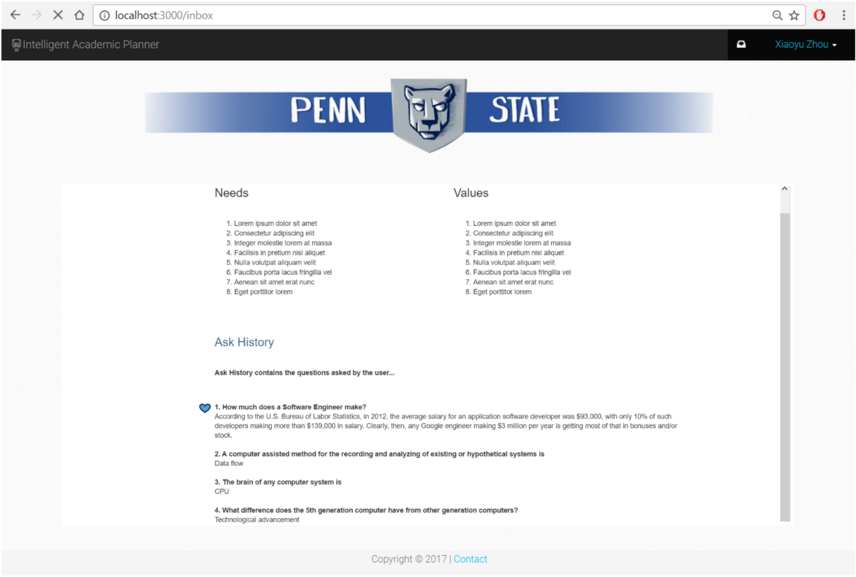

Slide 25
Lessons Learned

Slide 26
Language : | Javascript/ES6 | JSX
DB : | MongoDB
Framework : | Mongoose | Socket.IO | Watson-Cloud | React-Native
Service : | Watson+ | Twillio
AI Tech : | Retrieve and Rank | Natural Language Understanding
Theory : | Random Frost | Decision Tree | Boost Tree

Slide 27


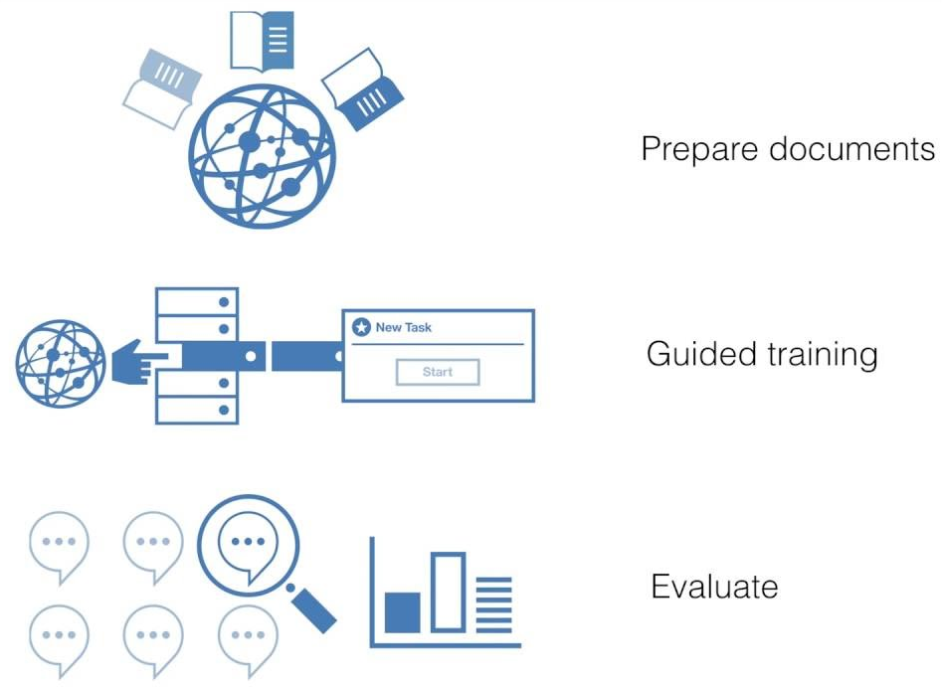



Slide 28



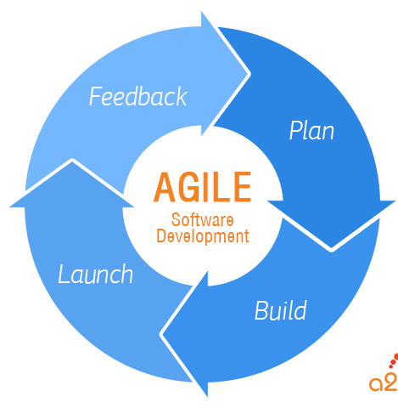



Notes:
Front end: responsive designs, javascript/jquery, design/styling, frameworks. Agile development and integration. Communication and teamwork. Git.

Slide 29

QUESTIONS?

